Slide 1
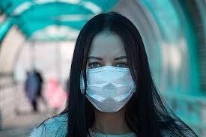
Hello world !

Slide 2
I am yaswanthi
And this is
Anju VILASHNI
& sai shreya

Slide 3
And we’re
Team
Coden’t

Slide 4
Today we present to you ….

Slide 5
r . A . C . c . e
XTENSION
EP
O
R
T
Y
B
E
R
R
I
M
E
ITS OUR RACE
AGAINST CYBER CRIMES

Slide 6

Problem !!!

Slide 7

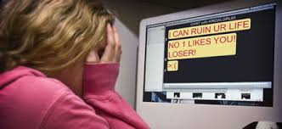


RACISM
PORNOGRAPHIC CONTENT
BODY SHAMING
OFFENSIVE LANGUAGE

Slide 8
To bring it to the notice of the cyber police while maintaining the anonymity of the claimant
SIMPLE SOLUTION

Slide 9
SO WHAT DOES r.a.c.c.e DO ??
Step 1: click on the extension .
it takes a screenshot of the chat or the page
Step 2 : enter the required details in the form – city or state and social media platform .
Step 3 : when you click on the submit button , the form details and the screenshot of chat are emailed to the respective cybercrime branch of the city or state .
The email id of the respective cyber branch is obtained from a database where in the city or state and email id are mapped

Slide 10
Other features :
Anonymity of the claimant is maintained as the email is sent from a third email id and no personal information is collected. Not everyone would want their identity to be exposed when it comes to issues like these and therefore user privacy is necessary to be maintained .
Being an extension, it is easily accessible and easy to use.
It is an instant process and doesn’t involve cumbersome processes
The email id of the respective cyber branch is automatically obtained from the database , based on the city or state selected by the user in the form .

Slide 11
Scope
This project can be expanded and can be enabled in each application the times to come , such as Instagram , facebook etc.
This application can be expanded to various countries based on their standards of cyber police.
This extension has the scope for developing into a fully fledged application that may work with the government for ensuring internet safety .

Slide 12
Tech stacks
Python
Javascript
JSON
Chrome extensions
HTML
SQLite 3
Flask
SMTP
MIME

Slide 13
So ..
Are You
Ready to
R.A.C.C.E ?

Slide 14
thanks!
Any questions?

